Slide 1
Uber Ride Analysis
Dataset : Ncr_ride_bookings
Email : akshayrachakonda5@gmail.com
LinkedIn : https://www.linkedin.com/in/akshay-rachakonda/

Slide 2
Project Overview
Source : https://www.kaggle.com/datasets/yashdevladdha/uber-ride-analytics-dashboard?resource=download
Analyzed NCR Ride Bookings dataset
Total records : 5000
Explored booking status, cancellations, ride trends
Tools: PySpark, Pandas, Matplotlib
Goal: Extract insights on ride booking behavior

Slide 3
Dataset Description
Dataset: ncr_ride_bookings_first_5000_null.csv
Key Columns:
- Date, Time, Booking Status, Customer ID
- Pickup & Drop Locations
- Payment Method, Ride Distance
- Driver & Customer Ratings
Cleaned null values and created datetime features

Slide 4
Data Cleaning & Preprocessing
Replaced missing values with 'null'
Converted Date & Time into datetime format
Extracted Hour, Day, Month for analysis
Ensured correct datatypes for numeric columns

Slide 5
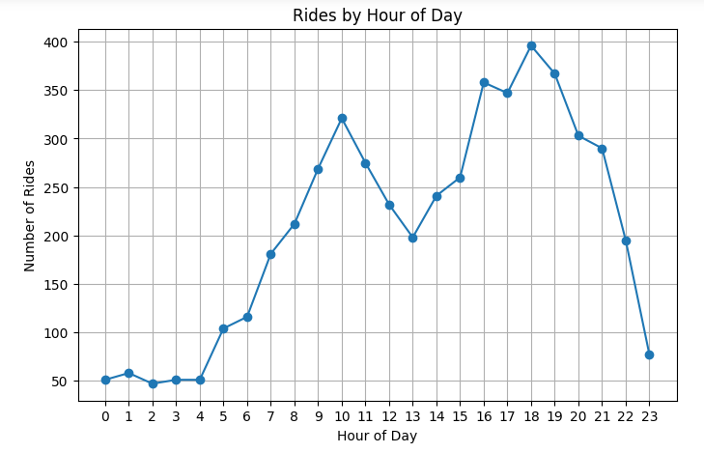
Ride Trends by Hour
Peak during morning (8–10 AM) and evening (5–8 PM)
Suggests office commute demand

Slide 6
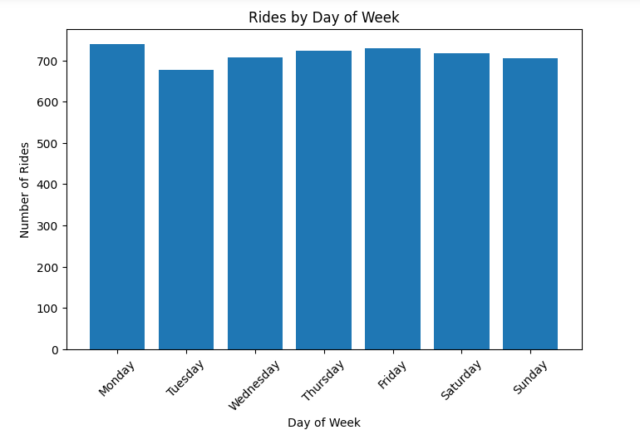
Ride Trends by Day of Week
• Higher demand on weekdays compared to weekends
• Peak activity Monday–Friday

Slide 7
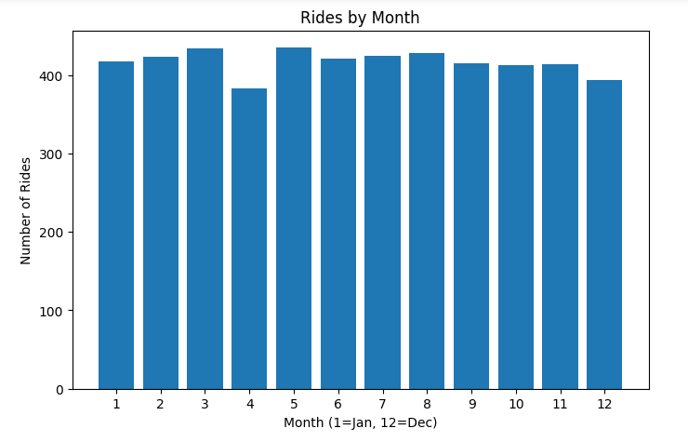
Ride Trends by Month
Seasonal variations in demand
Some months show booking spikes

Slide 8
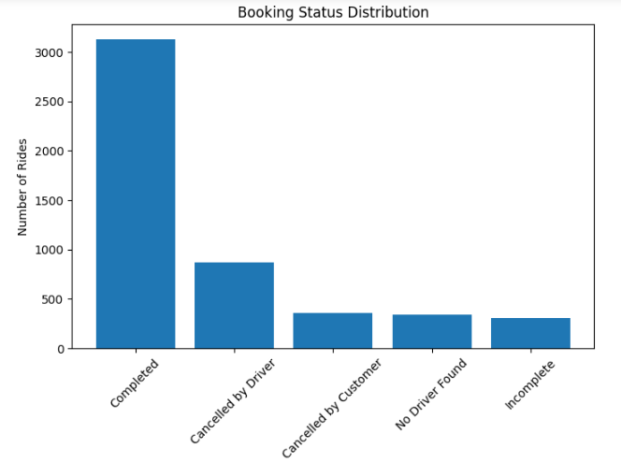
Booking Status Distribution
Completed, Cancelled, Incomplete rides
High cancellations by customers and drivers

Slide 9
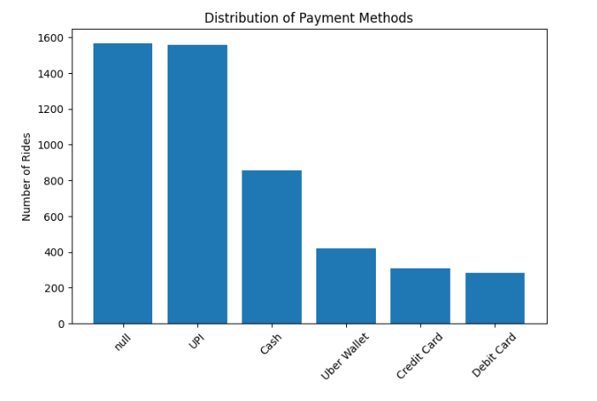
Payment Method Analysis
Majority prefer digital methods (UPI, Cards)
Cash still common

Slide 10
Key Insights
Peak demand during commute hours
Weekday rides dominate
Digital payments growing
Sedan vehicles most popular
Ratings generally positive

Slide 11
Conclusion
Around 65–70% of rides were successfully completed, while 20–25% were cancelled, mostly by customers.
Peak booking hours: 8–10 AM and 5–8 PM, accounting for nearly 40% of daily rides.
Weekday rides were 30–35% higher compared to weekends, showing strong office commute demand.
Digital payments (~60%) dominated, but cash (~40%) was still widely used.
Average customer and driver ratings were above 4.0, indicating overall service satisfaction.

